Slide 1
5 Voices
How to Effectively Communicate with Everyone You Lead
OVERALL BRIEFING CLASSIFICATION:
UNCLASSIFIED
Day 2 Seminar

Slide 2
Opening
The 5 Voices model places emphasis on communication and cognitive diversity
Recognizing personal Voice preferences impacts a leader’s communications and interactions
Understanding personal Voice preferences and triggers for Weapons Systems promotes organizational harmony
Successful leaders align personal Voice preferences with team and organizational goals
Notes:
30 sec / 1:30
“Before our session started, I asked three people to help me out....would those three people please stand and each read one learning objective
“This lesson along with the follow-on small group seminar are designed to achieve three learning objectives.”
“The next 30 minutes will set the framework for application in small groups.
“It may be important to begin with a brief discussion on defining values....”
TRANSITION TO NEXT SLIDE

Slide 3
Lecture
Thoughts on lecture?
How does understanding other voices improve team execution?
Notes:
30 sec / 1:30
“Before our session started, I asked three people to help me out....would those three people please stand and each read one learning objective
“This lesson along with the follow-on small group seminar are designed to achieve three learning objectives.”
“The next 30 minutes will set the framework for application in small groups.
“It may be important to begin with a brief discussion on defining values....”
TRANSITION TO NEXT SLIDE

Slide 4
Communication: It’s Important
Notes:
There is some online Gaming verbiage that includes mild “Profanity” in this video.
Recommend telling your seminar in advance

Slide 5
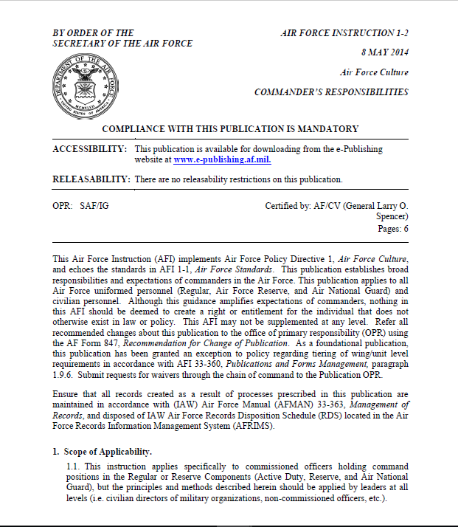
Why 5 Voices? …More Effective Communication
AFI 1-2 Commander’s Responsibilities
3.2. Lead People. Effectively leading people is the art of command. Commanders must maintain effective communication processes and ensure unit members are well disciplined, trained and developed. Commanders will enforce the Air Force cultural standards on conduct, performance and discipline outlined in AFI 1-1, Air Force Standards. Further, commanders will establish and maintain a healthy command climate which fosters good order and discipline, teamwork, cohesion and trust
Notes:
Reference saved here:
\\pnqs-cifs-002\fs-003\Eaker Center\CS\02. Courses\01. Course Directors\08. Sq-CC\3-Course Development\1-Content\1-Lesson Plans\8-Day 8\Deliberate Development References
- AFI 1-2 directs Sq/CC’s to personally and professionally develop Airmen at the squadron-level. Communication is a specific referrence

Slide 6
Cognitive Diversity through Communication
Do you see cognitive communication diversity in your workplace?
What are the advantages/disadvantages to this diversity in thought/communication?

Slide 7
The Core
IQ
COMPETENCY
EQ
CONNECTIVITY
THE CORE
PQ
SELF-AWARENESS
Notes:
See Tool resource and delivery guide for instructions
\\pnqs-cifs-002\fs-003\Eaker Center\CS\02. Courses\01. Course Directors\08. Sq-CC\6-References\GiANT\2018-09 GiANT Material\Tools
The top take away is that in the military we are pretty good at IQ (skillsets) We acknowledge EQ as important to leadership and modeling or avoiding leadership behaviors we see/experience, but we rarely spend much effort in PQ and understanding what it is like to be on the other side of your individual leadership style.

Slide 8
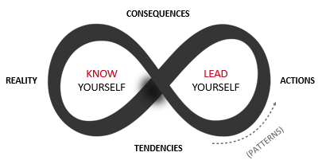
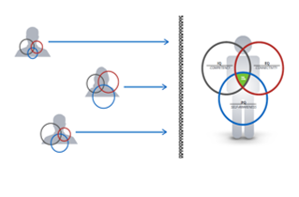
Drivers that Affect Your Behavior & Knowledge to Lead
CHOICE
Notes:
See Tool resource and delivery guide for instructions on Behavior Drivers Tool
\\pnqs-cifs-002\fs-003\Eaker Center\CS\02. Courses\01. Course Directors\08. Sq-CC\6-References\GiANT\2018-09 GiANT Material\Tools
Top takeaway is that your leadership behaviors are a combination of the natural tendencies, nurtured / environmental behaviors that were emphasized over your lifetime, and your integrated choices on what to focus on and develop.
Voices will help you understand some of those choices better

Slide 9
5 Voices
PIONEER
NURTURER
CONNECTOR
CREATIVE
GUARDIAN
Notes:
See Tool resource and delivery guide for instructions on 5 voices
\\pnqs-cifs-002\fs-003\Eaker Center\CS\02. Courses\01. Course Directors\08. Sq-CC\6-References\GiANT\2018-09 GiANT Material\Tools
Principal Takeaway
When you look at the visual tool, you recognize that different voices have different volumes. Some are often louder and more forceful in the way they bring their opinion and challenge the views of others.

Slide 10
5 Voices Assumptions
Our “Voice” is made of all 5 Voices
Some voices are more natural to us than others
Leadership maturity allows us to value the contribution each voice brings
Nature, Nurture and Choice have all played a part
Don’t assume you know someone’s foundational voice
Notes:
As we enter the voice assessment remember that you are no 100% in on any one voice and that the basis of the voice assessment is nature. Nurture will have an effect on your desired preferences.
And these assessments are all snapshot in time. They may change as your environment changes.

Slide 11
5 VOICES A S S E S S M E N T
L E T ’ S T A K E T H E

Slide 12
How to Rate Your Voice
GREEN
My Foundational Voice, my default pattern of communication & thinking
YELLOW
Not my Foundational Voice but I value it and it’s easily accessible
RED
Not my Foundational Voice, I find it hard to value and hard to access
Notes:
This is the process and the booklet that we will use to assess your REPORTED type.
You don’t have to be Red/Yellow/Green only.
The students can be Green with a hint of Yellow, Yellow with a hint of Green, Red with a hint of Yellow, etc.

Slide 13
Nurturer
WHAT IS A NURTURER?
Champion of people, always concerned about the relational health and harmony of the group
Completely committed to protecting values and principles
Have a hard time separating their work from who they are
Innately understand how certain actions, behaviors or initiatives will affect people
Notes:
The What is,

Slide 14
Nurturer
WHAT DO THEY BRING AT THEIR BEST?
Everyone deserves to be heard – they appreciate each contribution
They intuitively feel how an organization will react to a new idea
Pragmatic realism – has this really been thought through?
They defend values – people always come before profit
Function as the relational oil inside the organization
Commitment to relational harmony before/during/after meetings

Slide 15
Rate Your Nurturer Voice
GREEN
My Foundational Voice, my default pattern of communication & thinking
YELLOW
Not my Foundational Voice, but I value it and it’s easily accessible
RED
Not my Foundational Voice, I find it hard to value and hard to access

Slide 16
Nurturer
NEGATIVE IMPACT
Overly resistant to change & can be passive aggressive
Feel unable to challenge proposed direction when they disagree
Making money often seen as an impure motive
Don’t value the contribution they make
WHAT QUESTIONS ARE THEY REALLY ASKING INSIDE?
What are people going to be most upset about?
Who is going to hate this?
Is this really practical? Is it really going to happen?
Has the final decision been made?
Do they really want to hear what I think?

Slide 17
PAIRS EXERCISE
Turn to the person next to you: tell them what color you have rated your Nurturer Voice and why
Notes:
Spend no more than 5 Minutes on this exercise, it just allows the students to get to know eachother and talk through their interpretations.
This is also a good place to resolve any Questions

Slide 18
Creative
WHAT IS A CREATIVE?
Champions of innovation and outside the box thinkers
“Early warning radar system” that sees the opportunities and dangers of the future before everyone else
Never satisfied with the status quo—they always believe it can be better. The word “can’t” is not in their vocabulary
Ask the question: “Why do people never seem to fully understand my ideas?”
Long for an environment where they know their contribution is valued and appreciated
They are defenders of values and integrity

Slide 19
Creative
WHAT DO THEY BRING AT THEIR BEST?
Creatives see the future first, both in terms of long term opportunities and potential dangers
They are never satisfied with good enough
They are Conceptual Architects, able to see how all the pieces fit together
Capacity to think outside the box
Strong social conscience and a desire for organizational integrity

Slide 20
Rate Your Creative Voice
GREEN
My Foundational Voice, my default pattern of communication & thinking
YELLOW
Not my Foundational Voice, but I value it and it’s easily accessible
RED
Not my Foundational Voice, I find it hard to value and hard to access

Slide 21
Creative
NEGATIVE IMPACT
They can often fail to celebrate the 90% that has been achieved, focusing instead on the 10% that hasn’t!
Idealism often trumps pragmatism, leading to a sense of paralysis until they believe it can be perfect
Tendency to ignore financial constraints and other practical hurdles
WHAT QUESTIONS ARE THEY REALLY ASKING INSIDE?
So what? Does all this activity really get us nearer to delivering the big picture vision?
Are we compromising our values in a way that we might regret later?
Are you ready to listen to what I need to share?
Why are we limiting ourselves? How could we do it better?

Slide 22
PAIRS EXERCISE
Turn to the person next to you: tell them what color you have rated your Creative Voice and why
Notes:
Spend no more than 5 Minutes on this exercise, it just allows the students to get to know eachother and talk through their interpretations.
This is also a good place to resolve any Questions

Slide 23
Guardian
WHAT IS A GUARDIAN?
Guardians are champions of responsibility and stewardship
They respect and value logic, order, procedure and process
They seek clarity as well as logical and proven decision-making criteria even if they have to ask the tough questions to get there!
Guardians like to see established track records of success to justify trying something different
They can feel frustrated that they are sometimes seen as “raining on the parade” just because they are trying to make sure the team makes the best decision possible

Slide 24
Guardian
WHAT DO THEY BRING AT THEIR BEST?
Relentless commitment to ask the difficult questions
Selfless capacity to deliver the vision once it has been agreed
Long-term commitment to deliver on time and on budget
Custodian of resources and how money is invested/spent
Ability to detach decision-making from personal sentiments
Guard what we already have that is working

Slide 25
Rate Your Guardian Voice
GREEN
My Foundational Voice, my default pattern of communication & thinking
YELLOW
Not my Foundational Voice, but I value it and it’s easily accessible
RED
Not my Foundational Voice, I find it hard to value and hard to access

Slide 26
Guardian
NEGATIVE IMPACT
Inability to compromise when they have a strongly held opinion
Desire for truth & right decisions override feelings of others
Can appear overly critical of people and ideas
Tone and Tact
WHAT QUESTIONS ARE THEY REALLY ASKING INSIDE?
Is it worth the risk and investment?
Convince me that change is really necessary
Can we test the hypothesis before we go all in?
Am I at risk of being taken advantage of?
Are we honoring the past as we look towards the future?

Slide 27
PAIRS EXERCISE
Turn to the person next to you: tell them what color you have rated your Guardian Voice and why
Notes:
Spend no more than 5 Minutes on this exercise, it just allows the students to get to know eachother and talk through their interpretations.
This is also a good place to resolve any Questions

Slide 28
Connector
WHAT IS A CONNECTOR?
Champion of relationships and strategic partnerships
Connectors rally people to causes and things they believe in
Connectors believe in a world where everyone can play and get excited about future opportunities…and they want to make it happen!
Receiving appreciation and credit for making key connections is highly motivating and energizing for Connectors
Connectors often respond to challenges with: “Whatever we need, I can get it or I have a source”

Slide 29
Connector
WHAT DO THEY BRING AT THEIR BEST?
Capacity to maintain a large number of relationships
They know how to connect with people & their aspirations
Boundless creativity, energy & imagination
Connections to new opportunities and networks
Persuasive and inspirational communication
© GiANT WORLDWIDE

Slide 30
Rate Your Connector Voice
GREEN
My Foundational Voice, my default pattern of communication & thinking
YELLOW
Not my Foundational Voice, but I value it and it’s easily accessible
RED
Not my Foundational Voice, I find it hard to value and hard to access

Slide 31
Connector
NEGATIVE IMPACT
People-pleasing tendencies means they struggle to bring challenge
When they feel critiqued they sell harder
They don’t hear or engage fully with critical feedback
They hijack the conversation and bring it back to being about them
Passive aggression & withdrawal after their idea is rejected
WHAT QUESTIONS ARE THEY REALLY ASKING INSIDE?
What will make this idea connect with people?
You really can’t “see it”?
Is everyone still with me?
Are you aware of what I’ve done?

Slide 32
PAIRS EXERCISE
Turn to the person next to you: tell them what color you have rated your Connector Voice and why?
Notes:
Spend no more than 5 Minutes on this exercise, it just allows the students to get to know eachother and talk through their interpretations.
This is also a good place to resolve any Questions

Slide 33
Pioneer
WHAT IS A PIONEER?
Pioneers are champions of change and ingenuity
They approach life with an “anything is possible!” attitude
Pioneers believe visioning a new future is always the highest priority
They are always seeking to find the quickest, fastest and most efficient way to do things
Pioneers value “outside the box thinking,” interesting or different ways of doing things and tend to seek out the most interesting people to learn from and add to their body of knowledge

Slide 34
Pioneer
WHAT DO THEY BRING AT THEIR BEST?
Strategic military thinking to achieve the agreed objective
Courage to make difficult decisions and prioritize the vision
Communicate an attractive vision of the future
Capacity to align resources and people to make things happen
Tenacity, energy and a strong desire for the team to win

Slide 35
Rate Your Pioneer Voice
GREEN
My Foundational Voice, my default pattern of communication & thinking
YELLOW
Not my Foundational Voice, but I value it and it’s easily accessible
RED
Not my Foundational Voice, I find it hard to value and hard to access

Slide 36
Pioneer
NEGATIVE IMPACT
They appear arrogant with a “me-focused” agenda
They fail to hear or value all of the 5 Voices
Quickly get frustrated with those who don’t “get it”
“Back me or fight me!” when they present their ideas
Driving too hard with an insensitivity to the needs of others
WHAT QUESTIONS ARE THEY REALLY ASKING INSIDE?
Who says we can’t?
Do you really not “get it”?
Are you competent?
Have you got a proven track record?

Slide 37
PAIRS EXERCISE
Turn to the person next to you: tell them what color you have rated your Pioneer Voice and why
Notes:
Spend no more than 5 Minutes on this exercise, it just allows the students to get to know eachother and talk through their interpretations.
This is also a good place to resolve any Questions

Slide 38
Your Voices
Order your natural voices from 1 to 5 in workbook based on which one you believe is most natural to you (#1) to which is most unnatural (#5)
1.
2.
3.
4.
5.

Slide 39
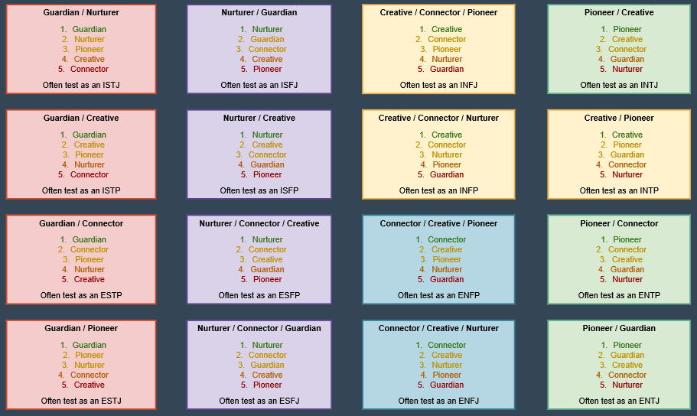
Nature Predications of Voice Order

Slide 40
Nature Foundational Voice
ISTJ GUARDIAN | ISFJ NURTURER | INFJ CREATIVE | INTJ PIONEER
ISTP GUARDIAN | ISFP NURTURER | INFP CREATIVE | INTP CREATIVE
ESTP GUARDIAN | ESFP NURTURER | ENFP CONNECTOR | ENTP PIONEER
ESTJ GUARDIAN | ESFJ NURTURER | ENFJ CONNECTOR | ENTJ PIONEER

Slide 41
Nature Predications of Voice Order
If left to NATURE alone this is the rank order we would expect
GBFE Type | Nurturer | Guardian | Creative | Connector | Pioneer
ISTJ | 2 | 1 | 4 | 5 | 3
ISFJ | 1 | 2 | 4 | 3 | 5
ISTP | 3 | 1 | 4 | 5 | 2
ISFP | 1 | 4 | 2 | 3 | 5
ESTJ | 3 | 1 | 5 | 4 | 2
ESFJ | 1 | 3 | 4 | 2 | 5
ESTP | 2 | 1 | 5 | 4 | 3
ESFP | 1 | 2 | 3 | 4 | 5
INTJ | 5 | 4 | 2 | 3 | 1
INFJ | 4 | 5 | 1 | 2 | 3
INTP | 5 | 3 | 1 | 4 | 2
INFP | 3 | 5 | 1 | 2 | 4
ENTJ | 5 | 2 | 3 | 4 | 1
ENFJ | 4 | 5 | 2 | 1 | 3
ENTP | 5 | 4 | 3 | 2 | 1
ENFP | 4 | 5 | 2 | 1 | 3

Slide 42
5 Voices Summary Table
Voice | Rank Order | Nature
Nurturer
Creative
Guardian
Connector
Pioneer

Slide 43
AHA’s!
Your 5th Voice by Nature is your
Conscious Incompetence!
Your 4th Voice by Nature is often
your Unconscious Incompetence!

Slide 44
Champions of…
Nurturer | Relational harmony, values and people
Creative | Future ideas, organizational integrity and social conscience
Guardian | Truth, stewardship of money and systems
Connector | Relational networks, branding and messaging and internal collaboration
Pioneer | Strategic vision, tough decisions and problem-solving
Notes:
Bottom line is that to be a truly effective commander you must realize the value that everyone brings to the team and create a communication environment that facilitates their value to the team and mission

Slide 45
Rules Of Engagement
When Leading Teams…
Nurturer | They want to hear your opinion No one is going to critique you immediately
Creative | Dream big – it’s ok to be wrong sometimes They promise to ask clarifying questions
Guardian | Keep asking the difficult questions They promise to stay engaged as long as we can
Connector | Sell your ideas as passionately as you can When we critique them it’s not personal
Pioneer | Please listen to everyone else’s view first Beware the strength of your critique

Slide 46
Discussion: Current Reality
Do you see alignment in your voice and the type of job you currently have in your unit?
Do you see alignment in your voice and the jobs or tasks you naturally pursue?

Slide 47
Break

Slide 48
5 Voices Weapon Systems

Slide 49
Weapons Systems Overview
Each voice has a Weapons System that it uses during communication
What is a Weapons System?
Mature: as a positive communication
Immature/under stress: hurtful or destructive communication tendencies that erode team effectiveness
If you don’t understand your triggers, your voice becomes a weapon…your organization/team becomes less effective

Slide 50
Triggers: feel taken for granted, not heard, values are being ignored, people you care about being treated unfairly
Immature use: can withdraw care and pull back from the team
NURTURER

Slide 51
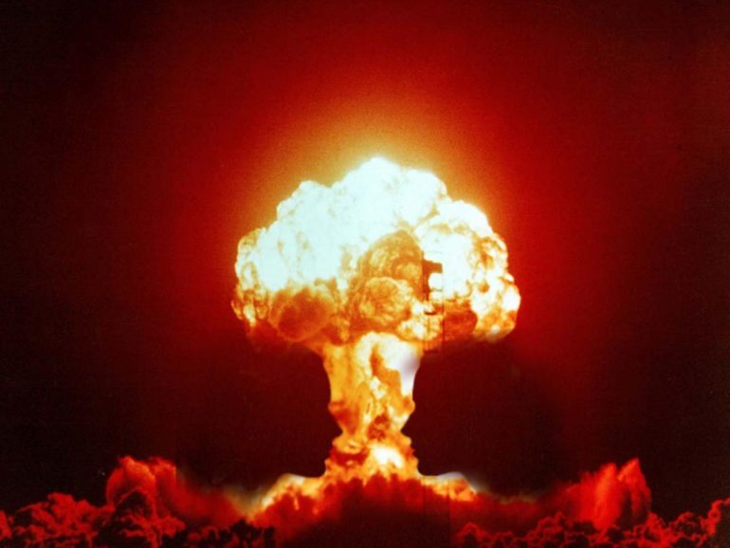
Triggers: values held dear being ignored/trampled, people you feel responsible for are treated poorly, broken promises
Immature use: can use a personal connection as a uncontrolled nuclear bomb tearing organizations or people apart
CREATIVE ( F)
Notes:
The Creative Feeler brings a perspective that is crucial to success and looking forward with eyes wide open, but can unleash overwhelming responses and criticism that will erode not just one person but the entire team.
The creative Feeler brings values based decisions to the team and a people focused perspective. That is their weapon for good.
However if triggered they can use that personal connection as a uncontrolled nuclear bomb tearing organizations or people apart just for being near tthem.

Slide 52
Triggers: incompetence or inefficiency, arrogance, people appearing to dismiss ideas, exaggeration of the truth
Immature use: can execute targeted attack on individual or input
CREATIVE ( T)
Notes:
The Creative Thinker brings the same advantages to the team, they are precise, analytical and forward thinking.
But if triggered they will very targeted attack on an individual or their input. It might not disrupt the entire team immediately but over time they can alienate large portions of the team because they are right and wrong at the same time
Picture
Staff Sgt. Joseph Pico trains at the firing range on Francis S. Gabreski Air National Guard Base, N.Y., July 17, 2015. Pico is a combat arms training and maintenance instructor with the 106th Rescue Wing. (New York Air National Guard photo/Staff Sgt. Christopher S. Muncy)

Slide 53
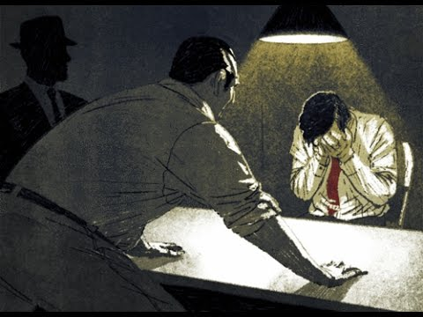
Triggers: loss or lack of trust in credibility of others, unnecessary risk taking, unresponsive arrogance, illogical people appear incompetent
Immature use: can stop progress of the team with interrogation style onslaught of questions and no regard to the cost in time or impact
GUARDIAN
Notes:
The Guardian is a foundation of truths, a protector of the process and the group and ultimately a cross check on the depth of impact in team action through second and third order effects analysis.
But they have the potential to stop all progress of the team with an interrogation style onslaught of questions with no regard to the cost in time or impact of the answer. Their distrust of team mates or lack of buy in on the risk can throw a wrench in the project moving forward or looking at things critically

Slide 54
Triggers: people take credit for work, people don’t recognize validity of ideas, sense people are not “for” you, people unwilling to collaborate
Immature use: works behind the scenes in a systematic destructive capacity exchanging information to erode relationships
cyber
warfare
CONNECTOR
Notes:
The connector can be the lifeblood of cooperative information exchange and spend days/weeks/months putting effort into building a relationship for a team win. The wepon for Good they bring is accurate and understandable messaging.
If triggered, placing them on the outside of the circle or taking credit for their hard fought win can result in them working behind the screens in a systematically destructive capacity exchanging information that erodes relationships through distrust or back room deals

Slide 55
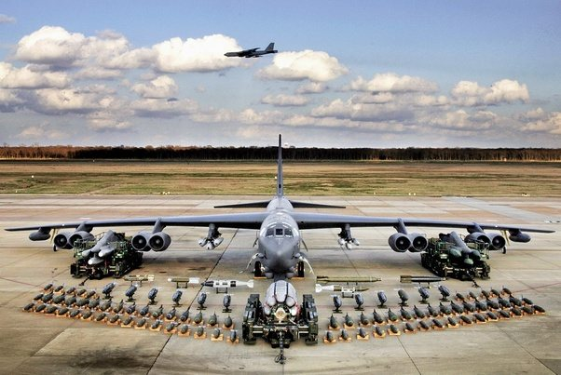
Triggers: perceived incompetence in others, people challenging their competence, people threatening their vision, time wasting
Immature use: can lay waste to a team at many levels
PIONEER
Notes:
The pioneer provides you a viewpoint into what “can be” for your squadron and mission. They are visionary and set a high bar looking well beyond the horizon, always thinking with a fast input/ constructive critique that keeps projects and communication moving forward.
However if triggered their influence can lay waste to a team at many levels if their vision is threatened, or there is a perception of them being incompetent or the incompetence in others that may inhibit efforts towards their goals

Slide 56
Understanding Weapons System
You can use weapon systems maturely and to your organizations advantage when you understand your tendencies

Slide 57
Exercise Understanding Weapons System
Group voices by type and have them discuss their interpretation of the weapons system
How may an immature leader unknowingly create a negative environment or impact communication?
Can a mature leader use the weapons system to an advantage?

Slide 58
Pairs Exercise Leadership Insights
Pick 2 leadership insights from your strongest voice that resonate with you
Discuss with your neighbor

Slide 59
How can we apply this?
Developing understanding of voices and communication as you lead an organization and the people in it increases communication and unit effectiveness
Models to follow…

Slide 60
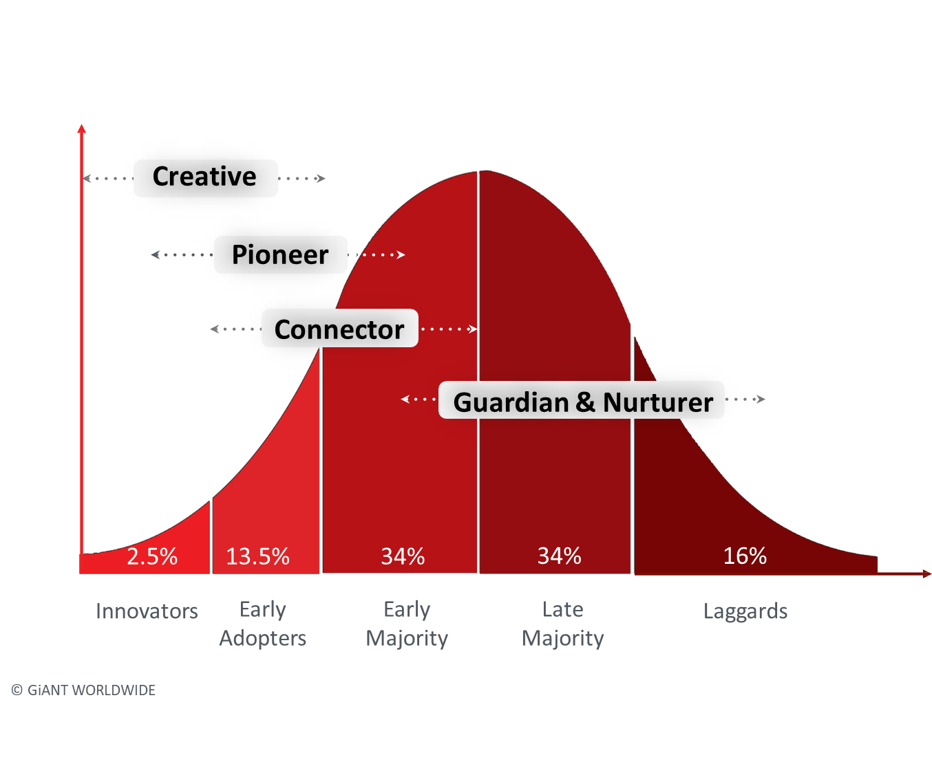
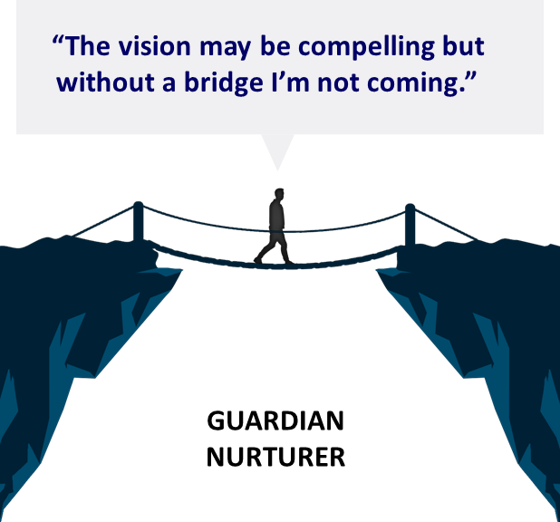
Communicating Vision

Slide 61
Support Challenge Matrix
High Support
PROTECTOR
Culture of Entitlement and Mistrust
Low Challenge
ABDICATOR
Culture of Apathy and Low Expectation
LIBERATOR
Culture of Empowerment and Opportunity
High Challenge
DOMINATOR
Culture of Fear and Manipulation
Low Support
Notes:
You will spend about 30 minutes here. See Tool resource and delivery guide for instructions on 5 voices
\\pnqs-cifs-002\fs-003\Eaker Center\CS\02. Courses\01. Course Directors\08. Sq-CC\6-References\GiANT\2018-09 GiANT Material\Tools
Tyndall Case study for discussion. What is challenge, what is support, where does a unit sit in the matrix?
This is one of the foundational tools for the course***This matrix works for individuals and orgs
When instructing begin with defining Support: Support from the followers perspective may appear different that Support from the leaders perspective. As a leader are you supportive of the development and growth of your Airmen? Do you give praise in public? Do your Airmen feel they can come to you with ideas and expect a “Yes if” or a “No because” answer
Now define Challenge: Challenge spectrum doesn’t just mean giving out tasks or looking for ways to change things. Is there opportunity for airmen to try new things? Do you care about what they are trying to do? Are you open to discussions and potential failure in experimentation? Do you expect the best or just the status quo?
- Liberator: Think of the goal being empowerment through support and opportunity through challenge. Thriving in Command!
- Protector: Low challenge, this is the norm and there's no reason to change it.. High support on the surface but sometimes its void of realistic, honest feedback for fear of upsetting the path of the ship. Do you say yes that's great idea/input but have no true intent to follow through?
- Dominator: Micromanager, drive results through fear of failure,
- Abdicator: Lack of interest in the Airmen/their needs, just “surviving” time in command.

Slide 62
Exercise: Leading Effective Change
Splitting or small group with your neighbor
Discuss your biggest “aha” moment
End result is an understanding that you have leadership “blind spots” in communication and that the integration of voices into your team/group can help shore up those blind spots
Notes:
End result is an understanding that you have leadership “blind spots” in communication and that the integration of voices into your team/group can help shore up those blind spots.

Slide 63
How can you use 5 Voices as a Squadron Commander?
Know Yourself to Lead Yourself
Know Others to Lead Others
Effective Leaders
Understand the Power of
Their Voices
Effective Leaders
Understand the Power of
Others Voices
Notes:
See Tool resource and delivery guide for instructions on Know Yourself To Lead Yourself
\\pnqs-cifs-002\fs-003\Eaker Center\CS\02. Courses\01. Course Directors\08. Sq-CC\6-References\GiANT\2018-09 GiANT Material\Tools
Principal Takeaway:
This tool provides a way to look at your leadership style in a mirror by letting you deconstruct how well you understand the impact of the environment (reality) layered on your tendencies that results in actions and subsequently consequesnces. Its not a start stop circle.
The Reality of the environment in which you lead is heavily influenced by the Tendencies you have as a leader. The more aware you become of what those Tendencies are, the more emotionally intelligent you become, the more self-aware you become, the more you are able to begin Choosing, what your action going to be

Slide 64
Closing
Know your Voices
Know the Voices of others
Understand what triggers Weapons Systems
Communicate with intent
What if every Voice around your table was truly heard, valued, and appreciated?

Slide 65
5 Voices
How to Effectively Communicate with Everyone You Lead
Questions?

Slide 66
Select 2 Leadership insights - Nurturer
When you speak you represent 43% of people. Your views and opinion truly matter!
People see you as a highly skilled professional. It’s time you started to believe that!
People chose you to lead because they believe in you. Act knowing that you belong!
Learn to challenge the views of other voices in your team when you believe they are wrong!
Embrace change and help lead it. Don’t be passive and function as a victim of it.
People trust your judgment and genuinely want to hear your opinion. Use that as a springboard for influence, and speak the truth in love.
When people challenge your views and opinions they are trying to help. It’s not a personal attack!
Pioneers are not as insensitive and arrogant as you think. They just see the world differently to you!

Slide 67
Select 2 Leadership insights - Creative
Learn to celebrate the wins even if it wasn’t quite as perfect as you hoped
When members of your team critique your vision and ask for the details they are genuinely trying to help
Don’t play safe, give yourself permission to think outside the box
It’s ok to be wrong sometimes, it comes with the territory of creativity and imagination
What you see as an imminent opportunity or threat may actually be a
further away than you think
Financial realities are important, good enough may have to be good enough sometimes
People are not deliberately ignoring your ideas, it’s hard to truly hear a Creative
You don’t have to prove your worth to team mates, relax and trust the unique contribution you bring
© GiANT WORLDWIDE

Slide 68
Select 2 Leadership insights - Guardian
How you communicate is important (volume and sensitivity) – it’s possible for you be right and wrong at the same time
Learn to value the future orientated voices, they drive innovation and progress
Sometimes goal posts move on projects and it’s not anyone’s fault
Learning to compromise is a healthy part of team life
Be careful: constantly driving yourself and your team will eventually
lead to burnout and resentment
Take time to invest in your key relationships today, you are not defined by task achievement alone
Your team know you are competent, do they know you care?
Networking events and social media platforms are not a waste of time
© GiANT WORLDWIDE

Slide 69
Select 2 Leadership insights Connector
When people reject your idea it’s not as personal as it sometimes feels.
Hinting at your frustrations with team mates does not guarantee anyone has truly heard you.
People will critique your ideas, try and avoid becoming overly defensive too soon.
It’s ok to be you - when you believe something passionately never be afraid to share it.
When you speak complete your sentences and stay focussed on one
idea at a time.
Be consistent in your external communication, avoid the temptation to sell to individuals ahead of the meeting.
Be Intentional - take time to think through how you can create a
culture where other voices can bring their best.
Be patient with those whose due diligence process is rigorous, painful and time consuming.
© GiANT WORLDWIDE

Slide 70
Select 2 Leadership insights - Pioneer
Beware the intellectual superiority complex, you don’t have all the best ideas, sometimes you are actually wrong
Take time to truly hear the views and opinions of others on the team,
memorize the rules of engagement
Please make sure your safety catch is always on, in a moment of frustration you can do a lot of damage with a grenade launcher
Only 7% of people view the world through your eyes. Remember, winning is not the driving motivation for most people.
Your team knows you are competent, they are not convinced you know anything about them or their life outside of work
Find a Nurturer and ask them to mentor you in how they see the world
Take time each day to encourage someone who doesn’t deserve it
If you are wrong, fight your initial instinct to justify your decision and deflect blame. You will earn respect and influence if you own up to your mistakes.
© GiANT WORLDWIDE

