Slide 1
Institutional Effectiveness
I n t e g r i t y - S e r v i c e - E x c e l l e n c e

Slide 2
Overview
What Is Institutional Effectiveness (IE)?
Why is IE Important to CCAF?
Why is IE Important to You?
How is IE Used at CCAF?
How is IE Used at Your School?
Questions/Discussion

Slide 3
What is Institutional Effectiveness
Institutional effectiveness is the systematic, explicit, and documented process of measuring performance against mission in all aspects of an institution. … A commitment to continuous improvement is at the heart of an ongoing planning and evaluation process. It is a continuous, cyclical process that is participative, flexible, relevant, and responsive.
SACSCOC, Resource Manual
for the Principles of
Accreditation (2012)

Slide 4
The Nature of the IE Process
Mission
Use of Results
for Improvement
Goals/ Objectives/
Expected Outcomes
Assessment, then
Evaluation

Slide 5
KEYS TO AN EFFECTIVE INSTITUTIONAL EFFECTIVENESS PROCESS
Start with the End in Mind
– Mission determines Objectives/Expected Outcomes
– Expected Outcomes determine appropriate assessment tools
– Evaluation of assessment results yield ideas for
improvements/refinement of mission

Slide 6
Reasons for IE
“The institution engages in ongoing, integrated, and institution-wide research-based planning and evaluation processes that (1) incorporate a systematic review of institutional mission, goals, and outcomes; (2) result in continuing improvement in institutional quality; and (3) demonstrate the institution is effectively accomplishing its mission.” SACSCOC, Resource Manual for the Principles of Accreditation (2012) CR 2.5
Planning
Improving Efficiency
Improving Quality
Accountability
Maintaining Focus

Slide 7
IE is Data Gathering
CCAF Institutional Effectiveness
Data
STARS
SQL
AFPC
COMMERCIAL SURVEYS
AFFILIATE SCHOOL INPUT
AFRS

Slide 8
CCAF IE
CCAF shares the regional accreditation with all 112 affiliate schools
Our accreditation allows us to give college credit to Airmen for the coursework they complete at your schools
Provides a means to show value of AF training and validates mission accomplishment
IE is more important than ever as Air University heads into its 2019 reaffirmation with SACSCOC

Slide 9
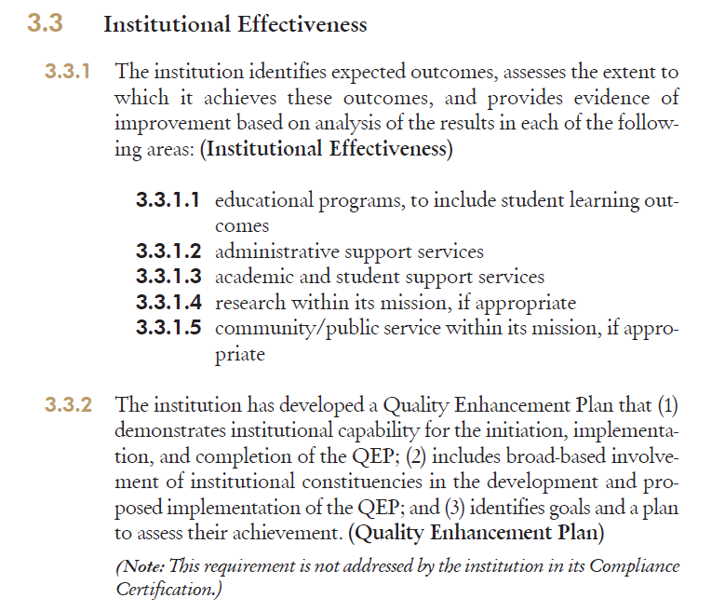
Why is Institutional Effectiveness Important to CCAF?
CCAF must meet SACSCOC requirements as stated
in the Principles of Accreditation.

Slide 10
Why is Institutional Effectiveness Important to CCAF?
CCAF’s IE Big Picture
71 degree programs
112 Affiliate Schools
All degree programs have the same five general learning outcomes
Each degree program also has a specific set of
learning outcomes

Slide 11
Why is Institutional Effectiveness Important to CCAF?
CCAF General Learning Outcomes
1. Write with clarity and precision for diverse audiences and understand and interpret the written expression of others.
2. Organize and deliver oral presentations to persuade, debate, argue or inform in a clear, concise and logical manner.
3. Understand and apply fundamental mathematical concepts and reasoning in problem solving.
4. Appreciate and value human diversity, individual differences, societies and the many expressions of culture.
5. Apply critical thinking skills as versatile problem solvers with enhanced mental agility and adaptability.

Slide 12
Why is IE important to you?
No other military service can offer college credit toward a regionally-accredited degree for skills learned in technical training and PME
Ensuring CCAF maintains accreditation helps ensure you and your peers get the maximum benefit for your military service

Slide 13
CCAF IE
We don’t intend to create more work for you at the affiliate school level, but it’s supremely important to make sure school data is flowing to CCAF
We want to show off the good work you do to senior Air Force leaders, as well as civilian accreditors
Focal point for all USAF enlisted education data, used to drive congressional actions, etc.

Slide 14
How is IE used in your school?
Specific IE processes vary by school and reflect diverse mission requirements
Some IE data pertains to every school
Graduation rate
Faculty/student ratio
The majority of data from affiliate schools comes in the Annual Report

Slide 15
How does this affect you?
Odds are you aren’t the IE POC at your unit
You should know who the IE POC is, and keep them in the loop as far as CRVs, data requests from CCAF, surveys, etc.
If your school’s IE processes are lacking, we will be happy to help you in any way

